Slide 1

Survey Search
by Pawsitive
Beth Bailey, Leoson Hoay, Ruixue Li
https://github.com/bethbailey/survey-search

Slide 2
Outline
Project Overview
Site Structure and User Flow
Awesome stuff we did
Challenges we faced
Future work
Demo (Yay!)
Questions/Comments

Slide 3
Project Overview
GOAL: Create an easy-to-use survey data repository.
What makes this different than other data repositories? Users can:
Search multiple surveys from different sources.
Search surveys on a granular level (for individual questions) as well as for entire surveys
Upload and share their own survey data

Slide 4
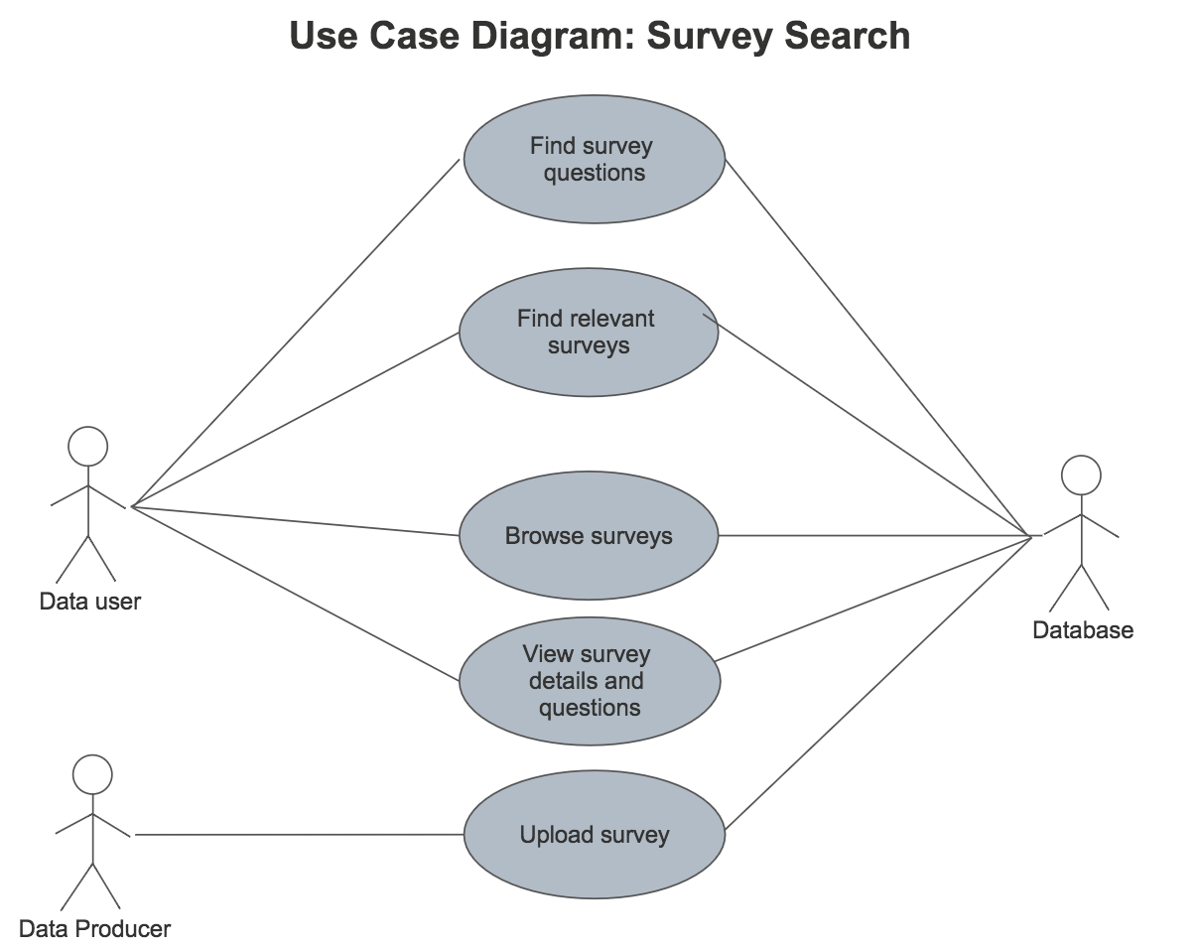

Slide 5
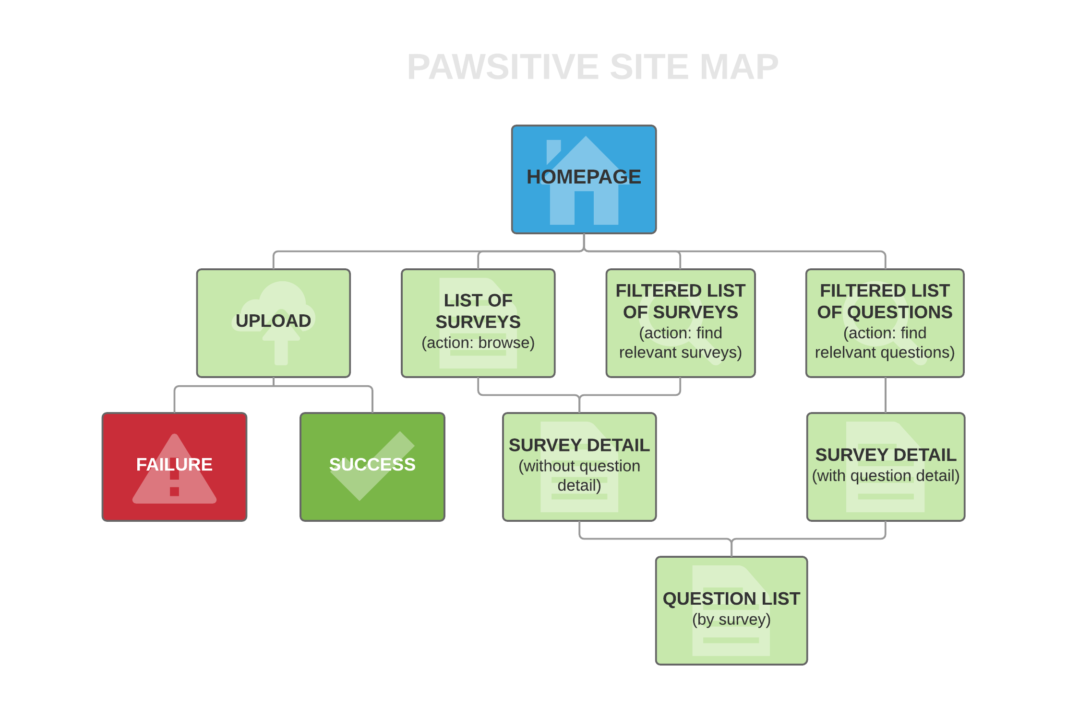

Slide 6
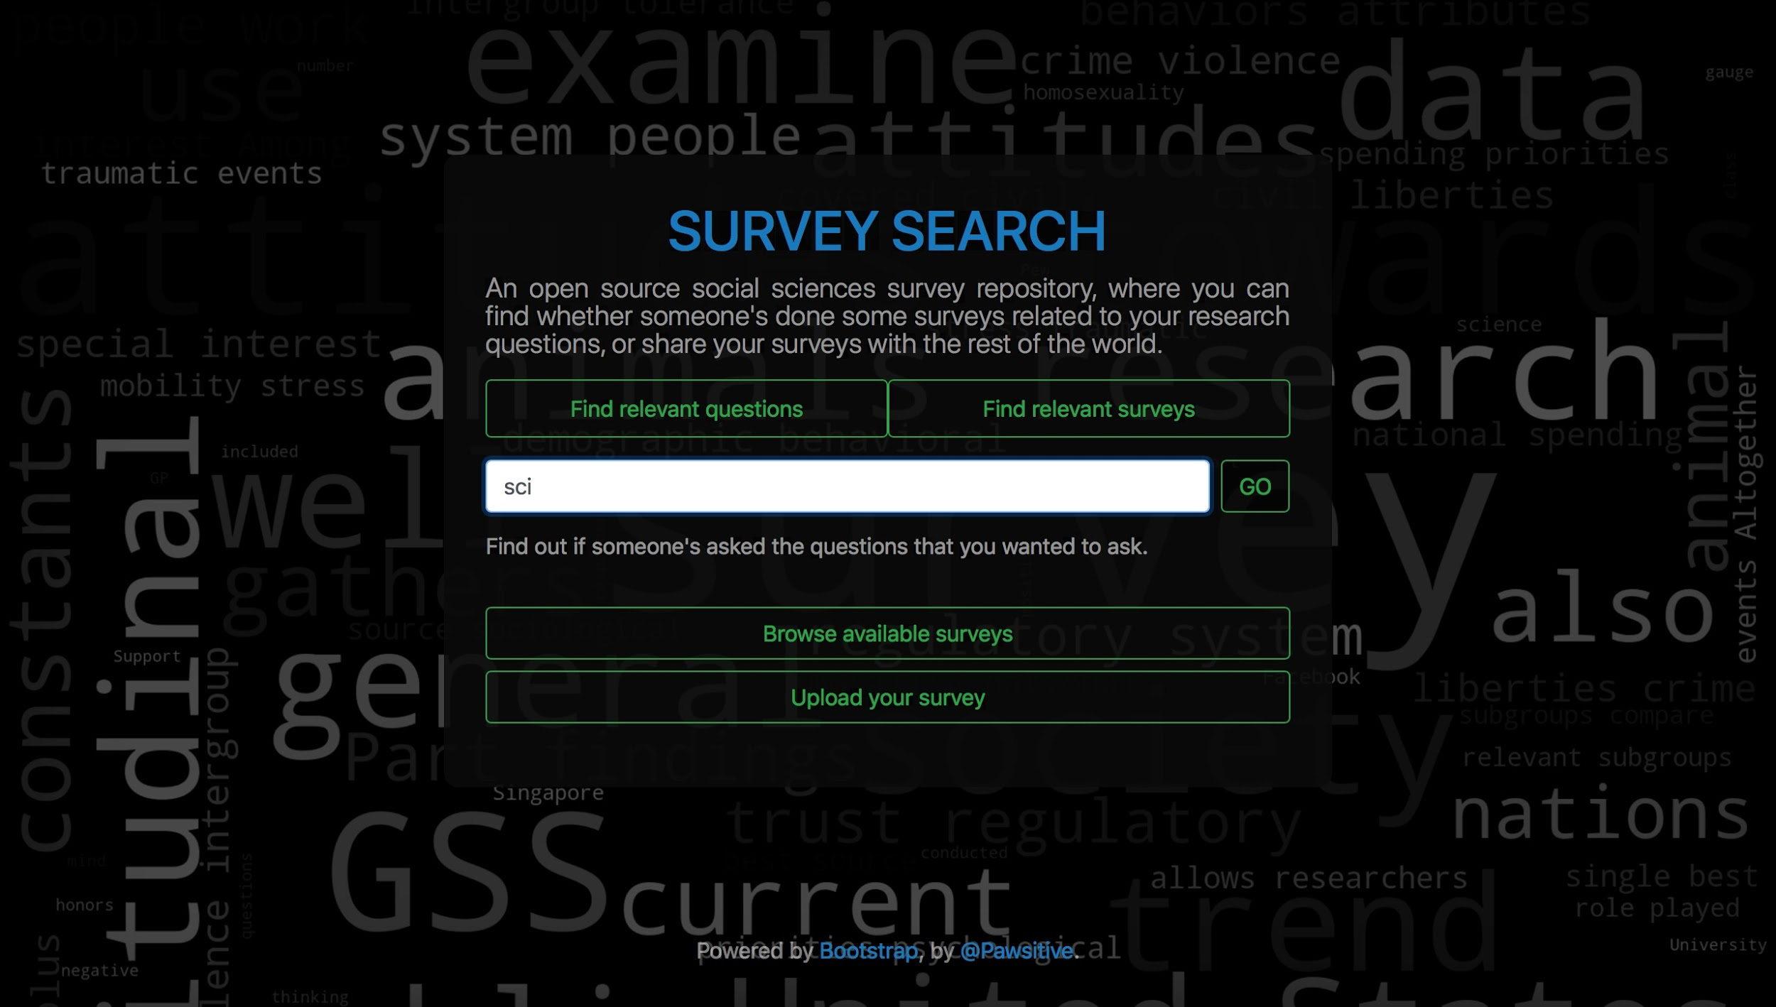
Cool Stuff We Learned!
Data processing/handling files in Python (pypdf2, docx2txt)
Data from surveys, such as the GSS, Pew surveys, and IPSOS surveys
Lucidchart
Building a website with Django
○TF-IDF (term frequency-inverse document frequency) based custom search algorithm (sklearn)
Bootstrap frontend
Word cloud generation

Slide 7
Challenges
Survey data cleaning is time-consuming and hard
Data is in many formats
Difficult to reuse code
A lot of programming involves using resources and reading documentation
Don’t be afraid to try things
Django’s modularity makes it versatile, but learning curve is steep
Integrating multiple modules: search, form, files, word cloud, etc.
Learning the best practices of software development
Version control
Teamwork is hard, communicate with and love your teammates <3
Notes:
Emphasize computational portion of data search

Slide 8
Features to come?
Shared search history/autocomplete
Visualization of search patterns
Advanced query engine
A smarter search that accounts for typos and word similarity
Show similar surveys (possibly using doc2vec)
Visualizations of survey data
User file upload directly to site (alternative to links)

Slide 9
Let’s do a demo!

Slide 10
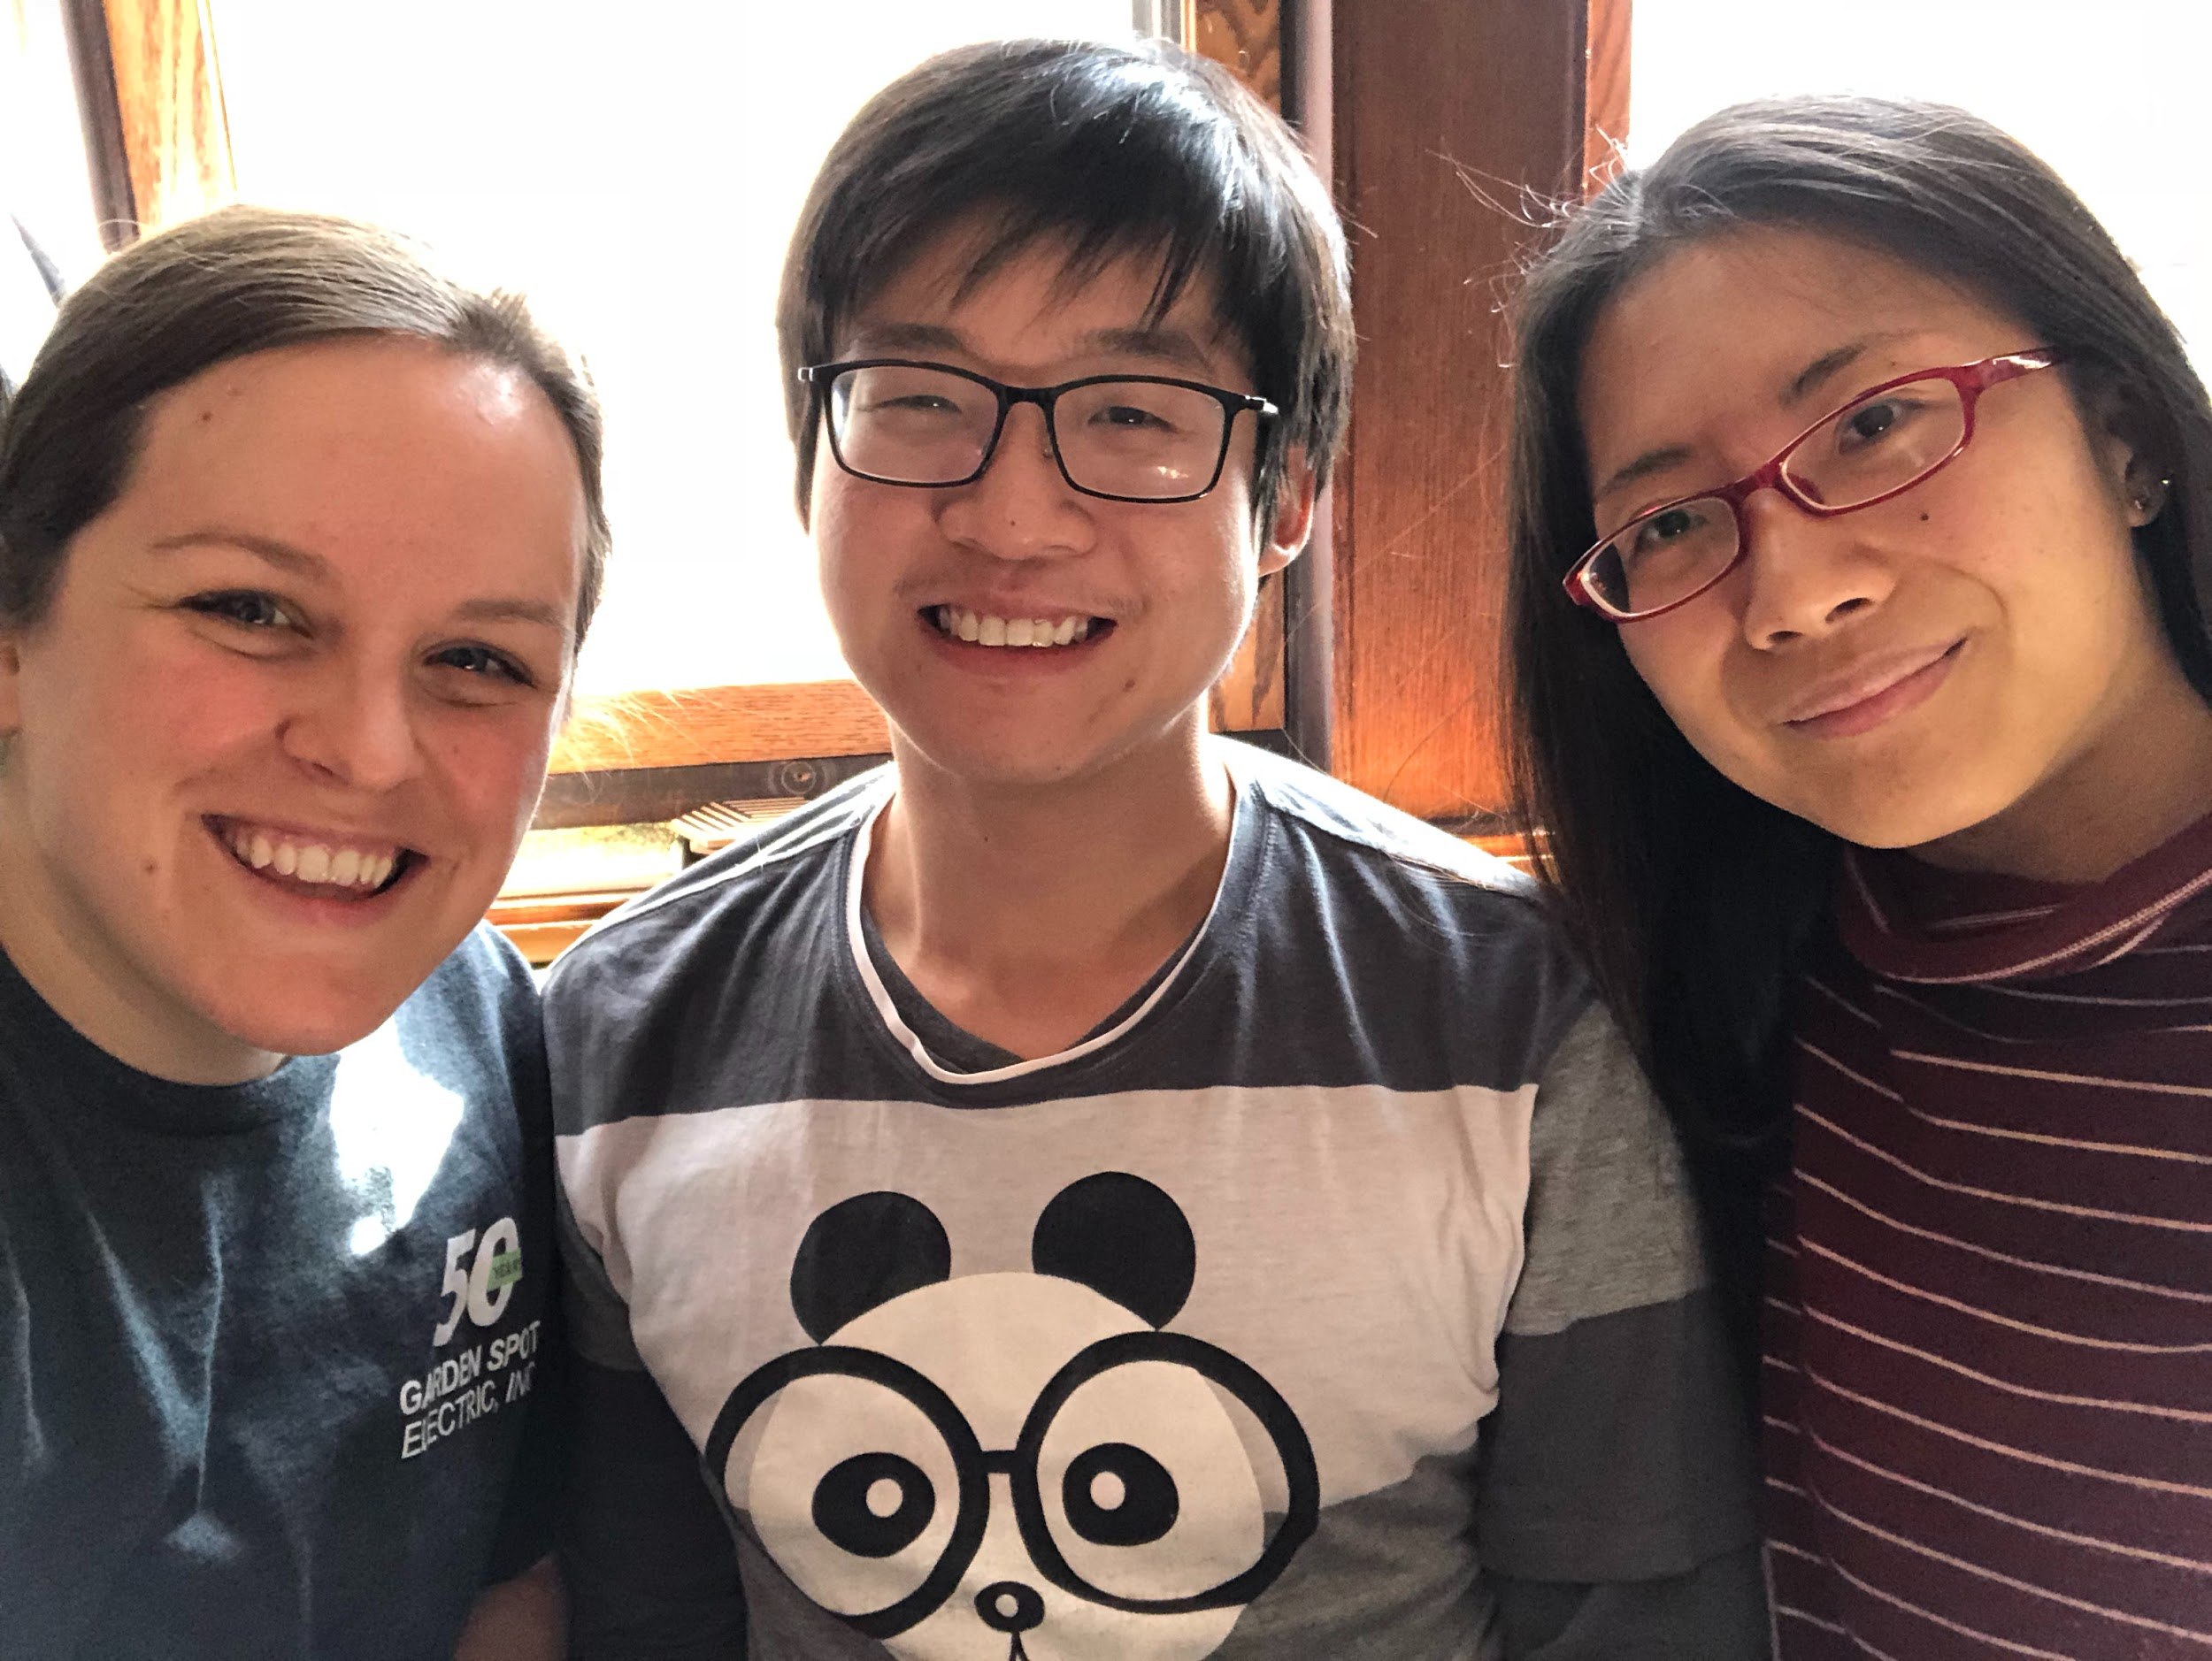
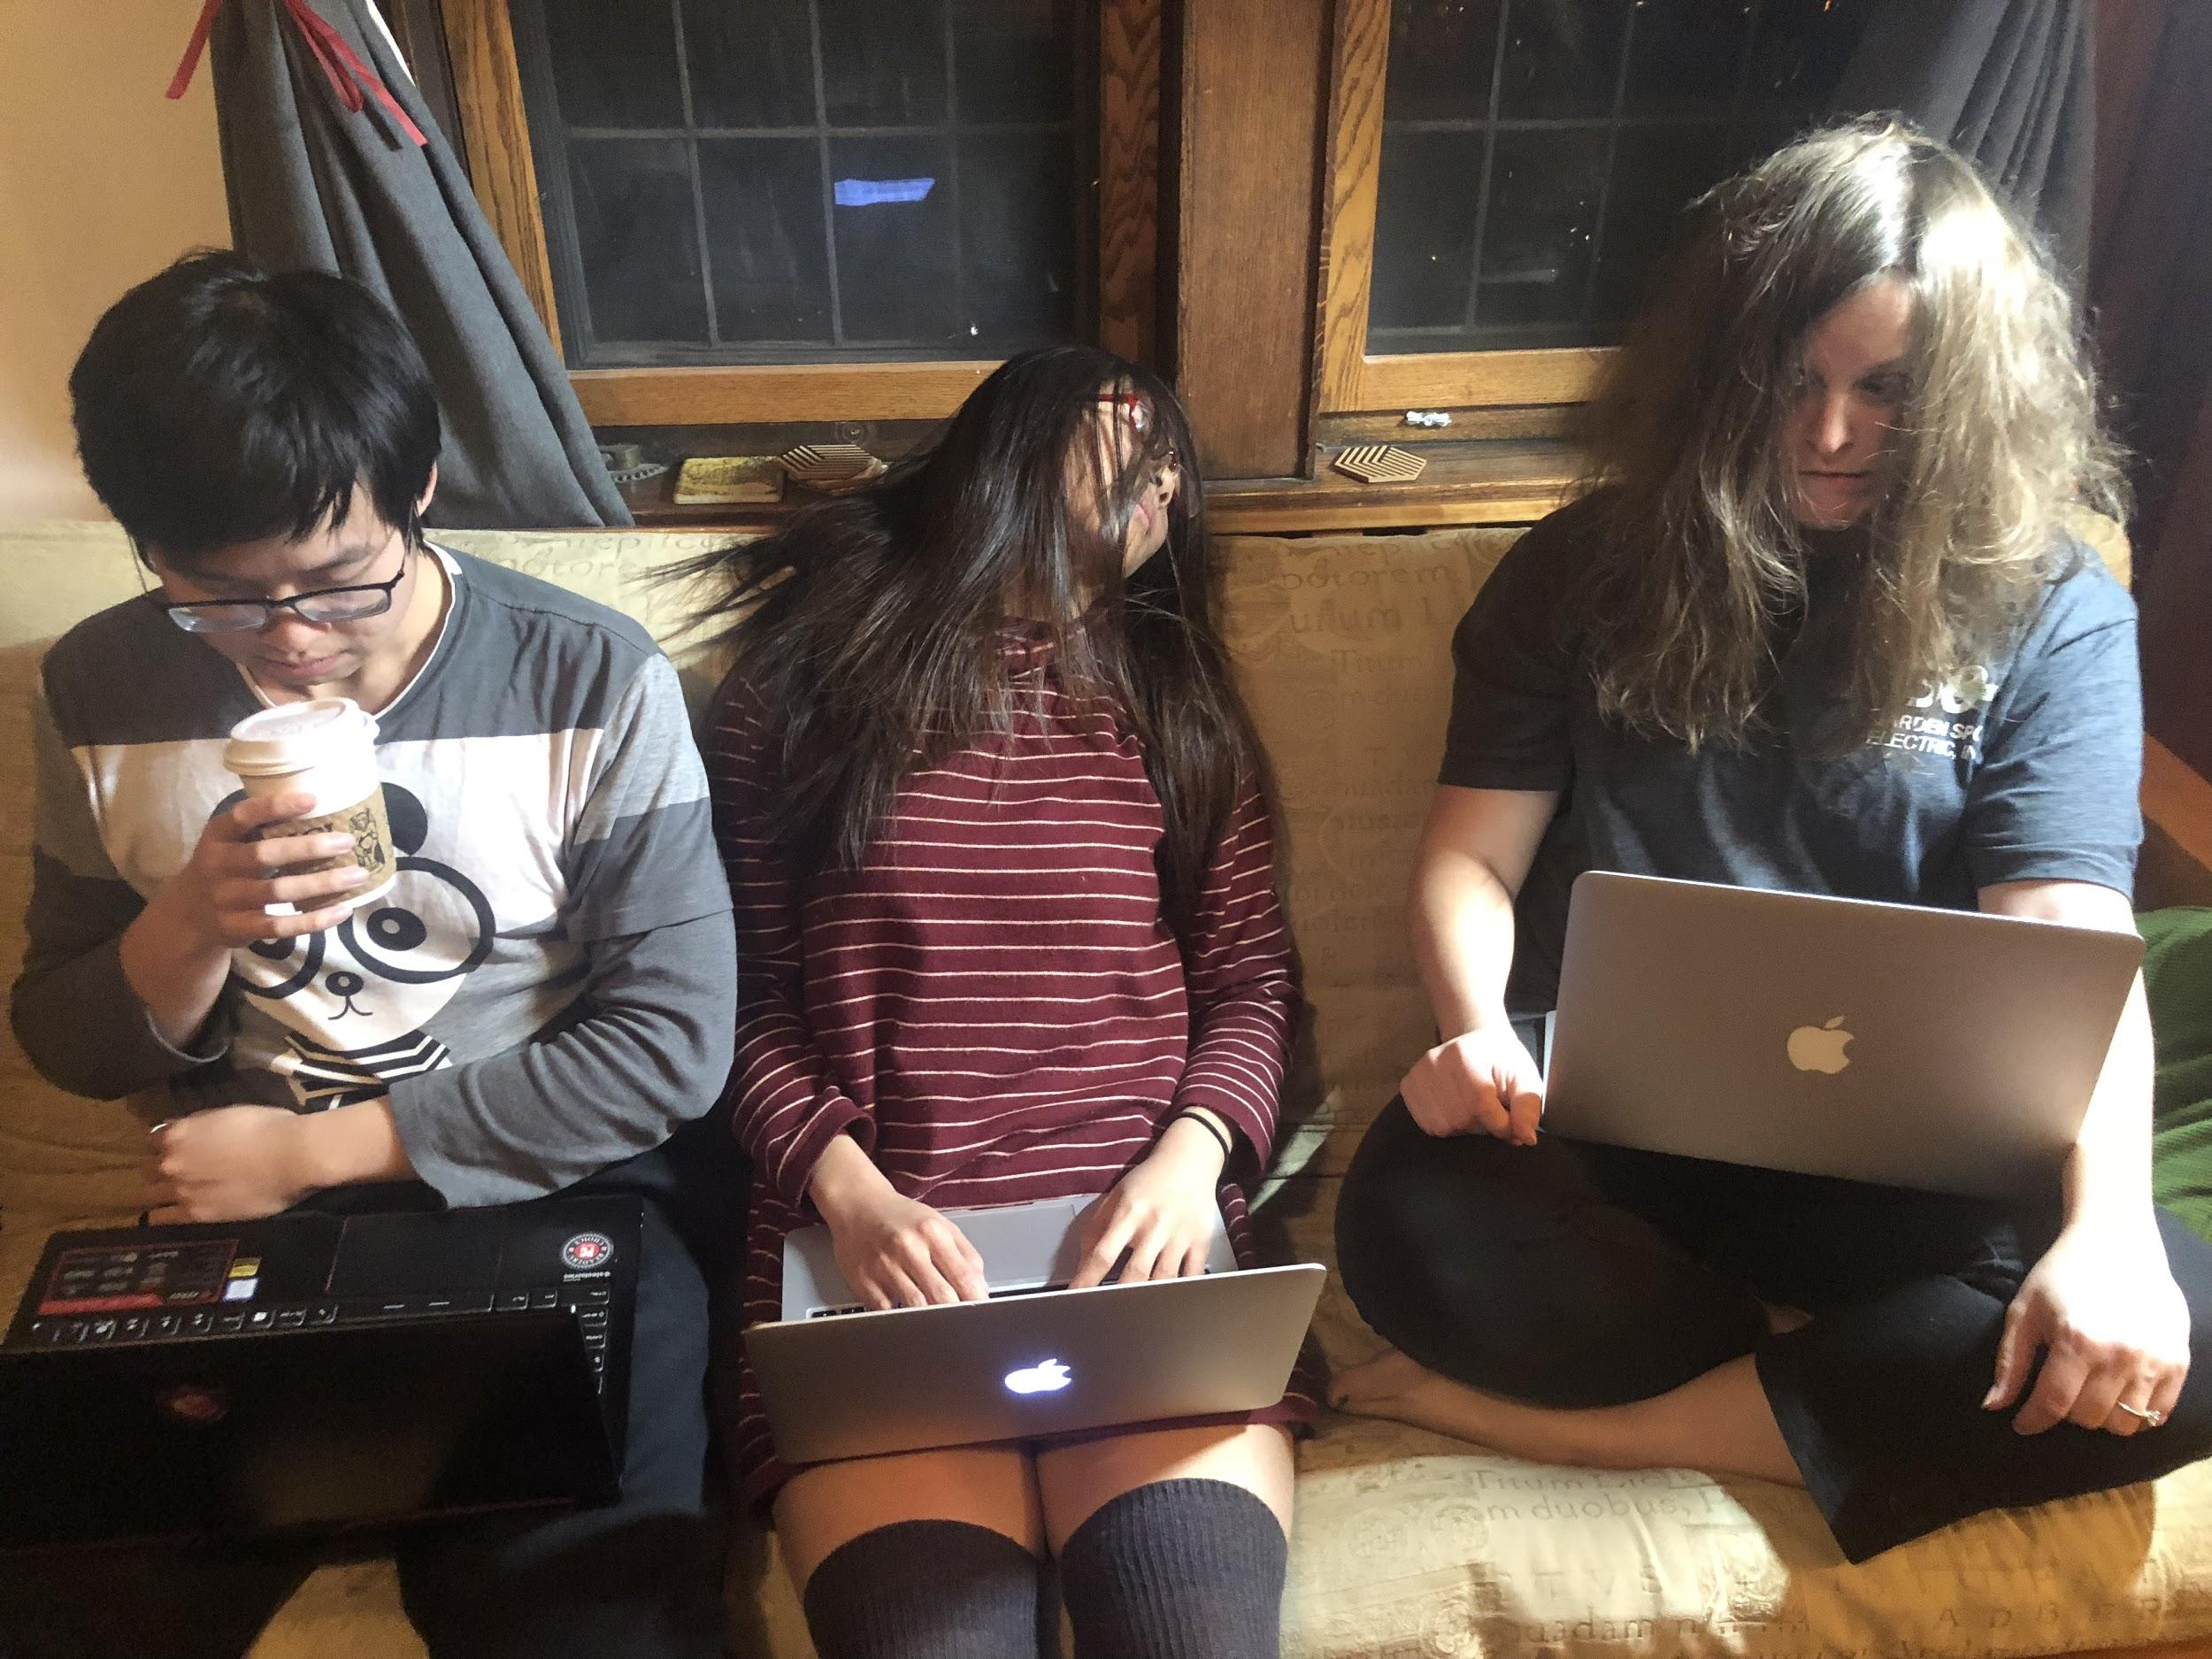
Questions/Comments?

